Slide 1

Case Study 1
Asset Intelligence

Slide 2
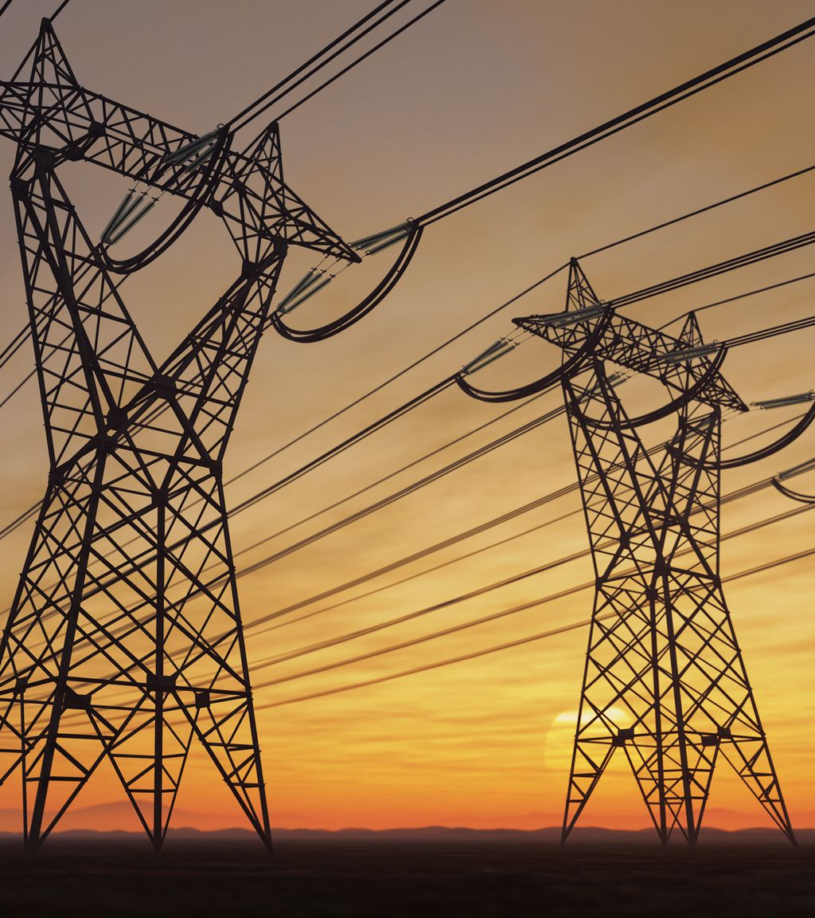

Asset Intelligence
AI can create and manage Portfolios in Asset Intelligence and find out the health of your assets to assist you make the best decision for the network.

Slide 3
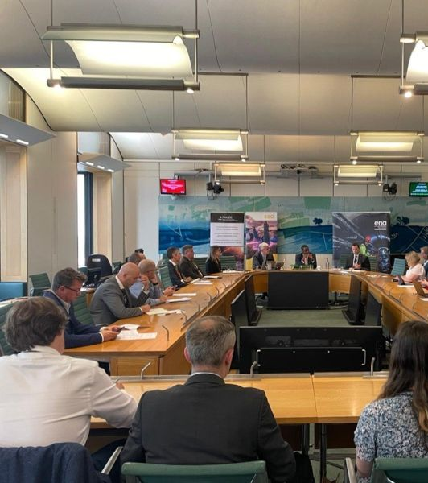



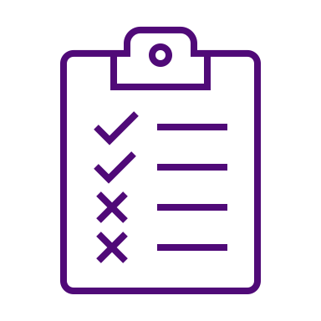
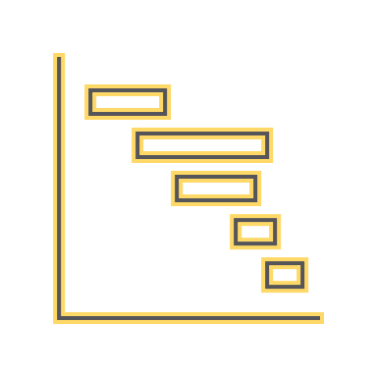
Journey Through identifying our Objectives and defining our Vision, Validation has confirmed the Value and led us to our Proposal.
Vision
Value
Objectives
Validation
Proposal
What will Asset Intelligence do?
What opportunities are available?
Why are we here?
How did we confirm our ambition?
What do we do next?

Slide 4

Asset Intelligence Features
Search Network
Find Sites, Towers, Asset FPs, Asset PIs, and much more. There are two types of networks: Substation Network (Asset PIs, Asset FPs, Bays, Sites) and Overhead Lines Network (Towers, Routes, NOMOHIds, Circuits, Spans)
Portfolio Library
Create, maintain, share, add intervention decisions, and more. There are two kinds of sharing: sharing with me and sharing with others.

Slide 5
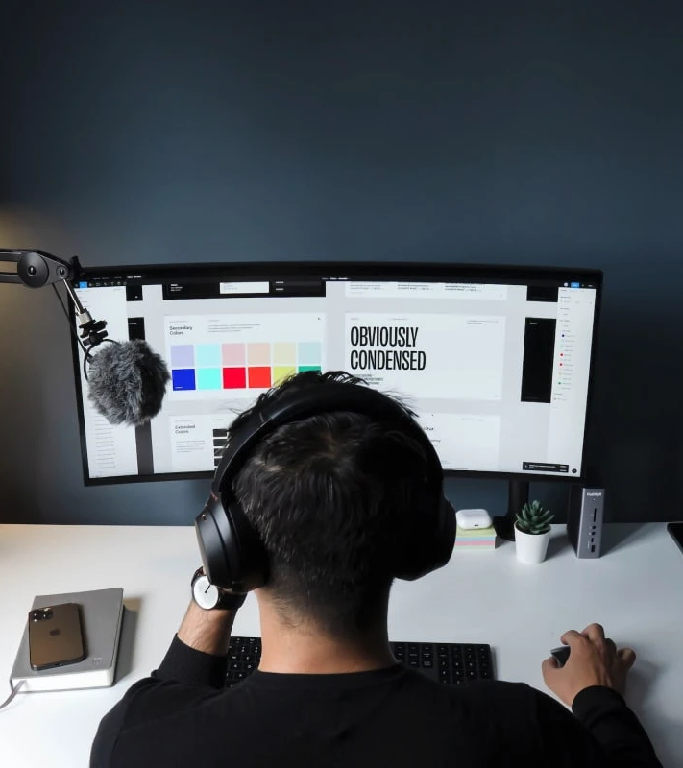
Roles and Responsibilities
UI Designer
The task is to ensure that every page and each step a user takes when they engage with the completed product adheres to the overarching vision provided by UX designers.
Design System
It is a set of reusable parts with very specific usage guidelines. These elements assist businesses achieve uniform visual design at scale by combining pattern libraries, color palettes, and typefaces with established design principles.

Slide 6
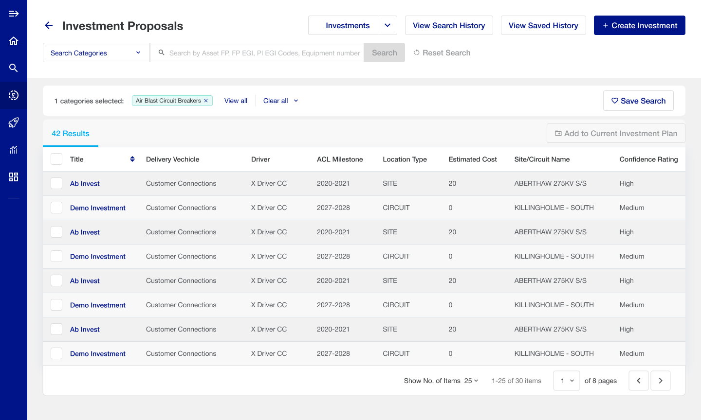
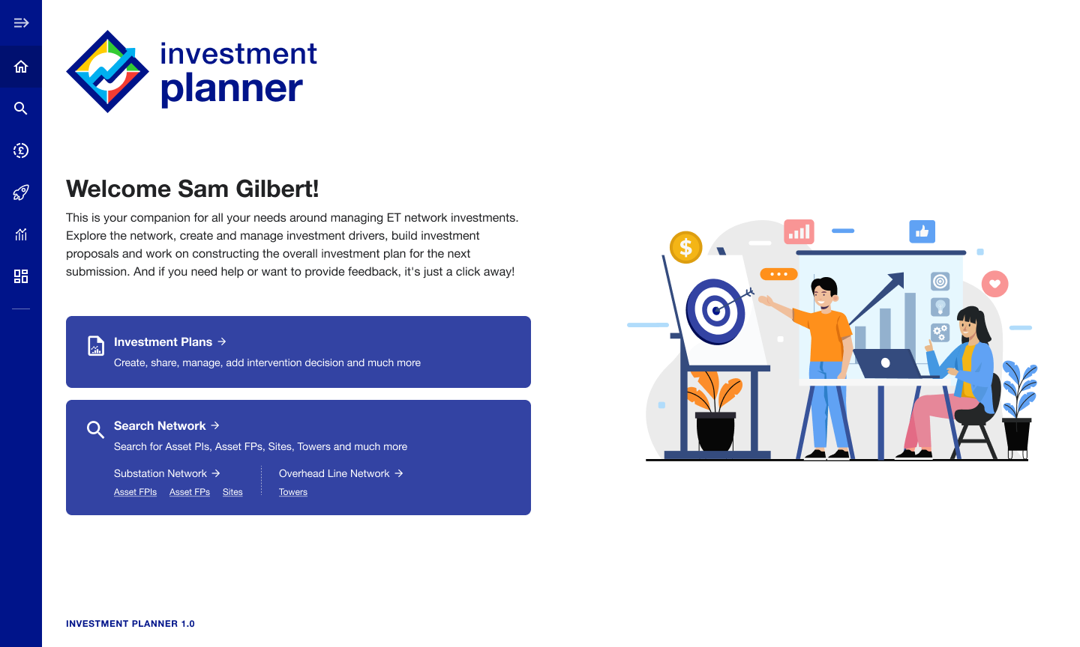
UI Designs
I'm in charge of designing the layouts and visual components that people engage with when using digital goods. The goal of UI design is to create interfaces that are visually appealing, simple to use, and intuitive. Meetings with stakeholders (such as managers, viewers, or colleagues) are frequently necessary in daily life to make sure designs live up to expectations.

Slide 7
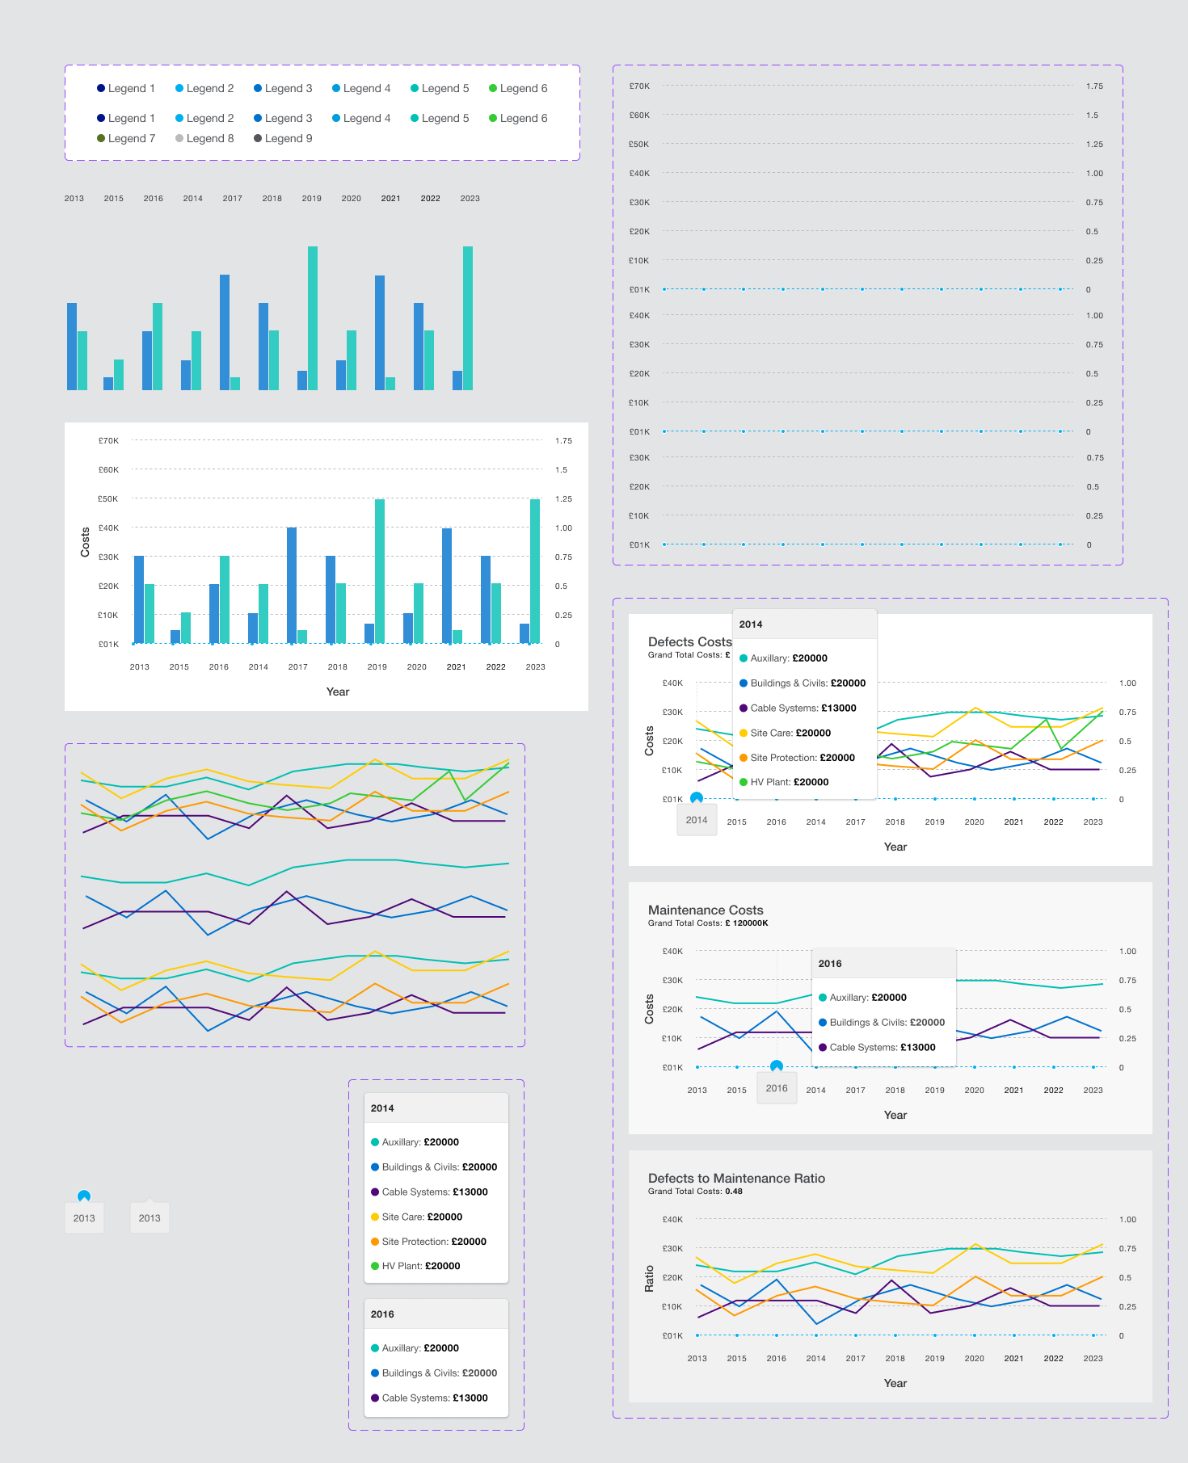
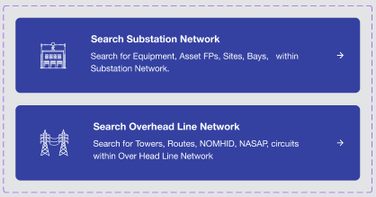
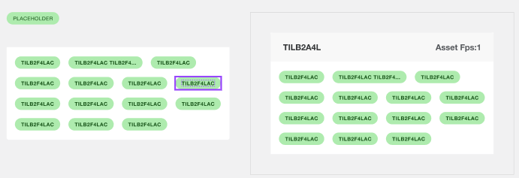
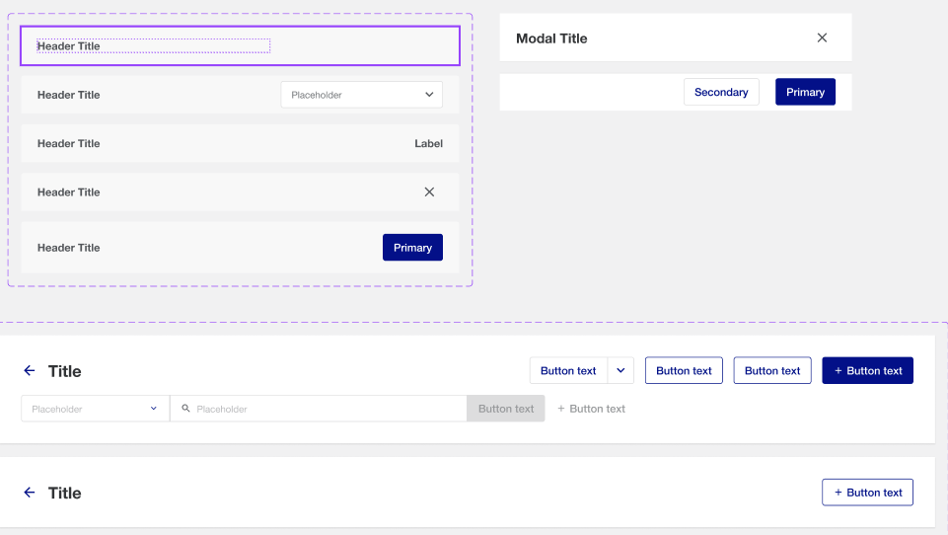
Design Systems
It is a set of reusable parts with very specific usage guidelines. These elements assist businesses achieve uniform visual design at scale by combining pattern libraries, color palettes, and typefaces with established design principles.

Slide 8
Case Study 2
PC 26 Investment Plan

Slide 9

PC 26 Investment Plan
This is companion for all the needs around managing ET network investments.

Slide 10

PC 26 Investment Plan Features
Investigate the network, develop investment drivers, make investment ideas, and work on putting together the overall investment plan for the upcoming submission.

Slide 11
Roles and Responsibilities
UI Designer
The task is to ensure that every page and each step a user takes when they engage with the completed product adheres to the overarching vision provided by UX designers.

Slide 12
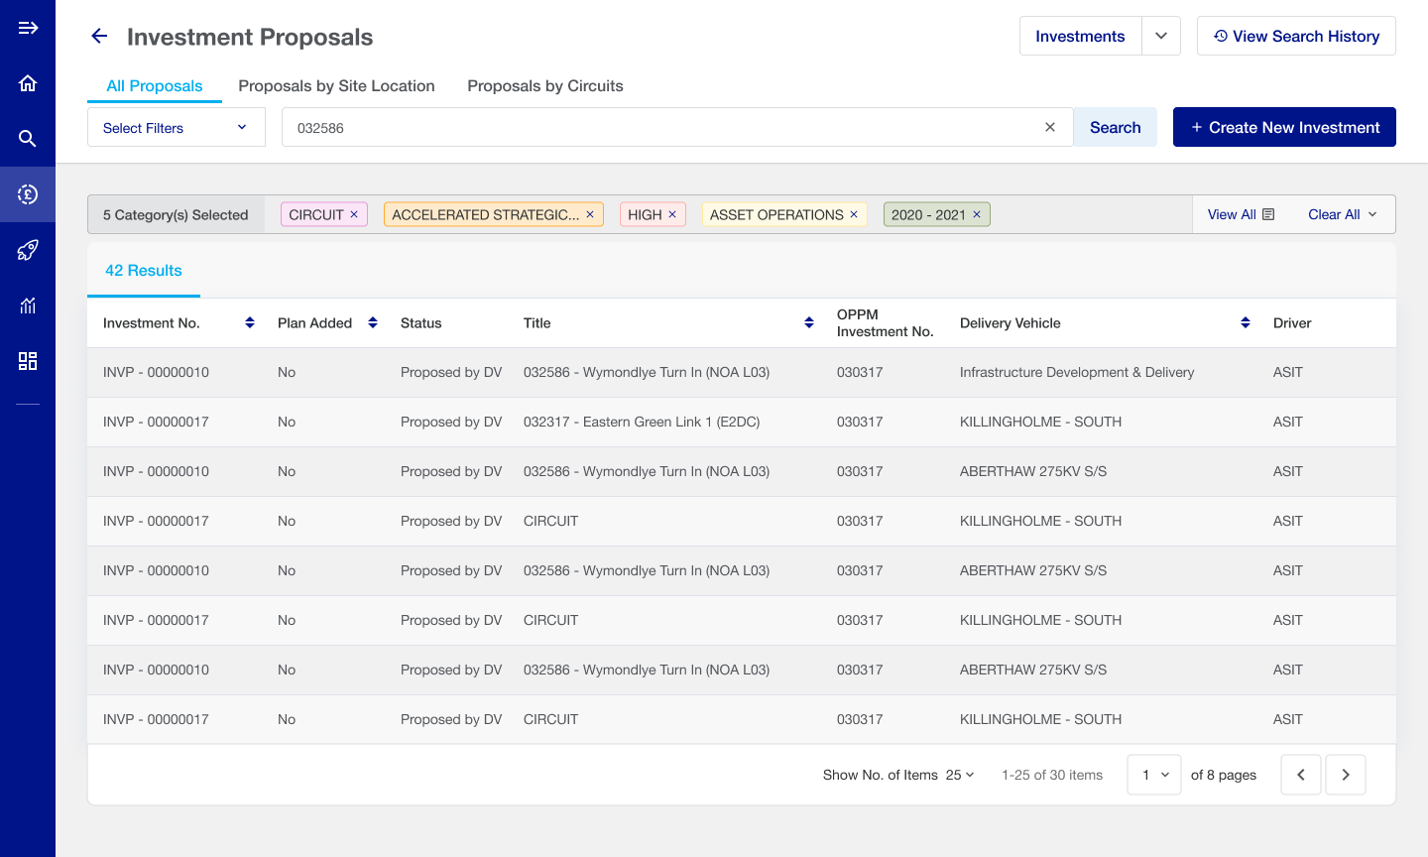
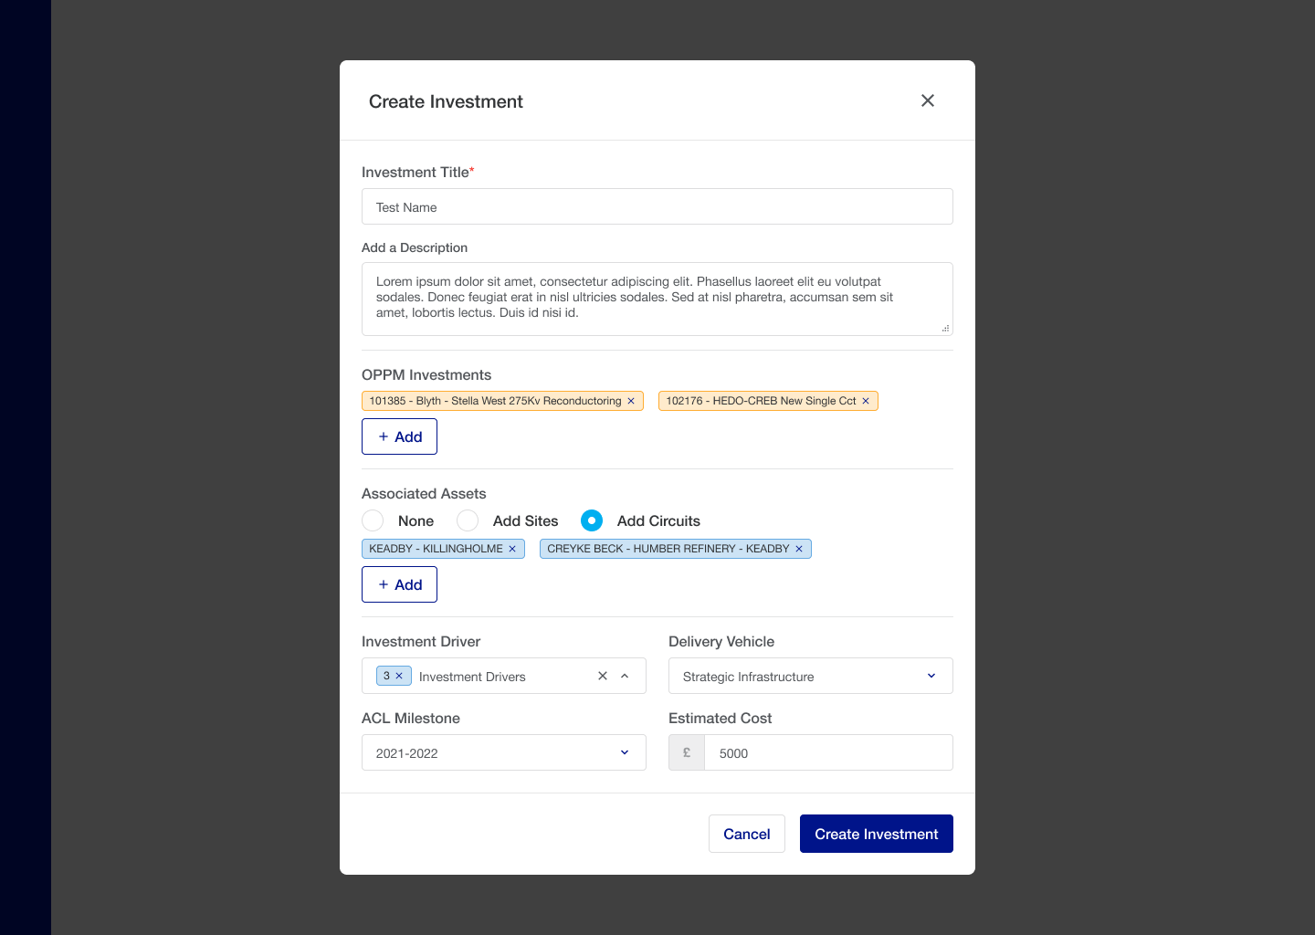
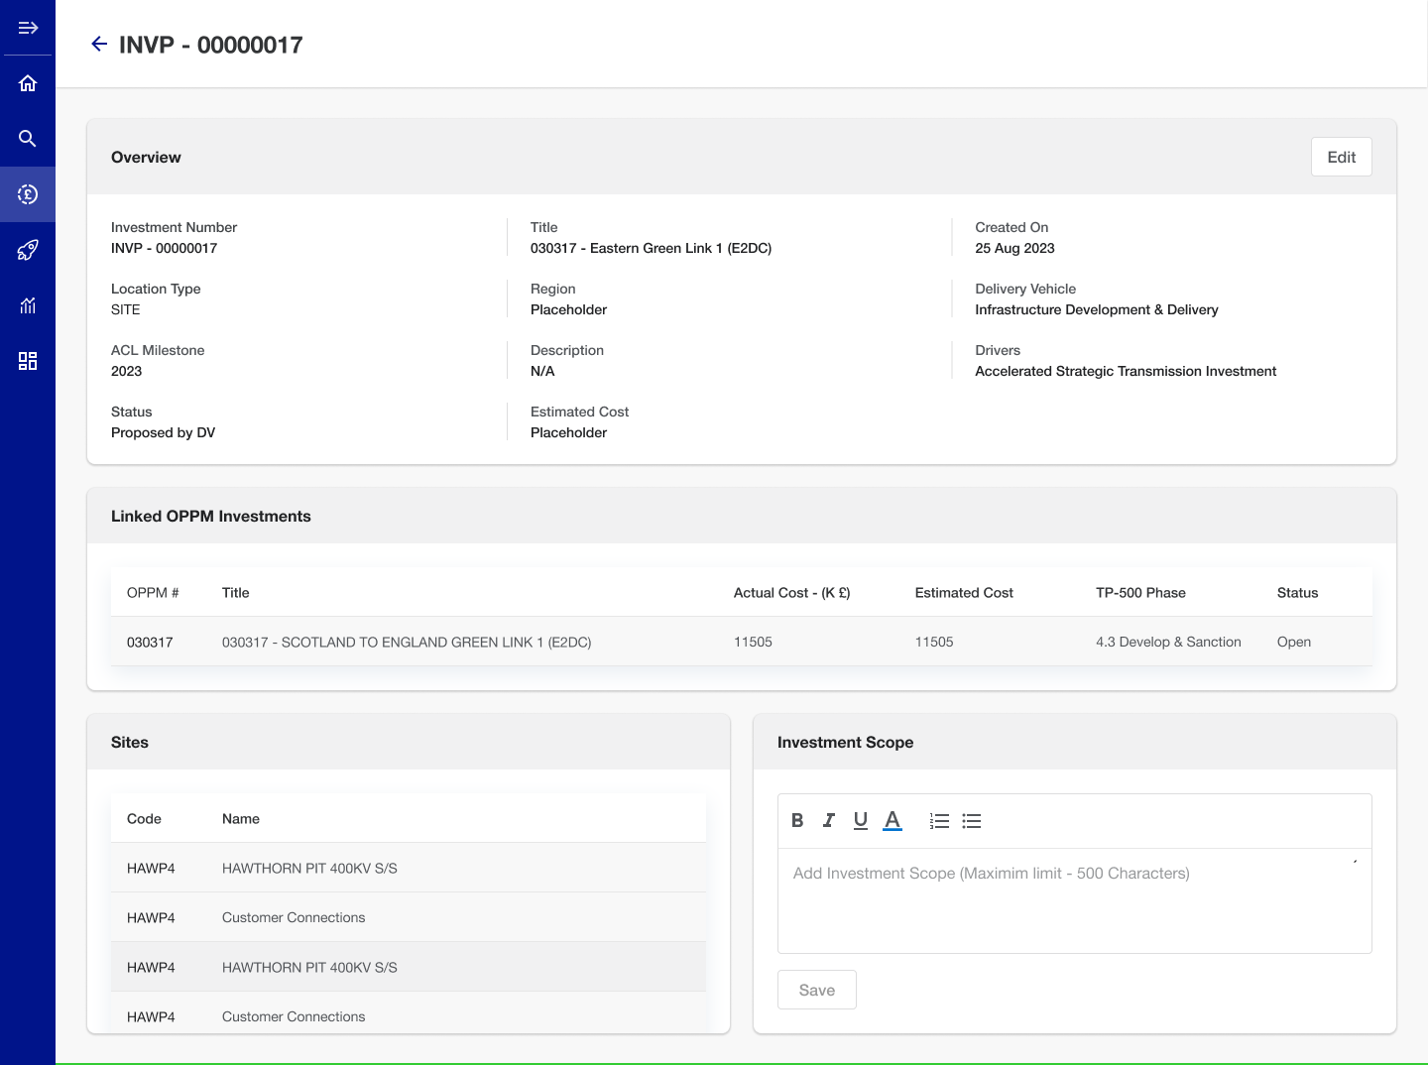
UI Designs
I'm in charge of designing the layouts and visual components that people engage with when using digital goods. The goal of UI design is to create interfaces that are visually appealing, simple to use, and intuitive. Meetings with stakeholders (such as managers, viewers, or colleagues) are frequently necessary in daily life to make sure designs live up to expectations.

